Slide 1
Movie Rental Power BI Dashboard
Capstone Project: Sakila Movie Rental Analysis
Tools Used: Power BI, Excel, SQL
Objective: To provide actionable insights into movie rentals, sales, inventory, and customer behavior.

Slide 2
Problem Statement
The DVD Rental store aims to understand its business performance across films, customers, staff, and stores.
Goals:
- Identify high-performing films and categories
- Analyze customer segments and payment behavior
- Improve store performance and operational efficiency

Slide 3
Data Source & Description
Dataset: Sakila Movie Rental Database
Tables Used: film, customer, rental, payment, store, inventory, staff, language, city, country
Total Records: 16,000+
Source: MySQL database exported to Excel and connected to Power BI

Slide 4
MECE BREAKDOWN
Category / Step | Description / Focus Area
Data Foundation | Collect data from Sakila Database → Clean, transform, and model (Star schema with fact and dimension tables).
Customer Analysis | Analyze customer demographics, active vs. inactive status, top customers by rentals, and average spending per customer.
Film Analysis | Identify top rented movies, analyze by category, rating, and language; study film length and rental duration patterns.
Revenue & Sales Analysis | Track monthly and yearly revenue trends; compare store-wise and category-wise revenue performance.
Store & Staff Performance | Evaluate store performance; analyze staff contribution to revenue and identify top-performing employees.
Rental & Inventory Operations | Study rental frequency, late returns, film availability, and relationship between film demand and inventory.
Language & Category Insights | Determine most popular languages and genres; assess profitability and rental frequency by category.
Visualization Layer | Create Power BI dashboards with KPIs, charts (bar, line, donut, map), and interactive slicers for filters.
Insights & Decisions | Highlight key insights to improve marketing, optimize inventory, enhance staff scheduling, and increase revenue.
Data Governance | Set up data refresh schedules, update relationships when schema changes, and ensure consistent report performance.

Slide 5
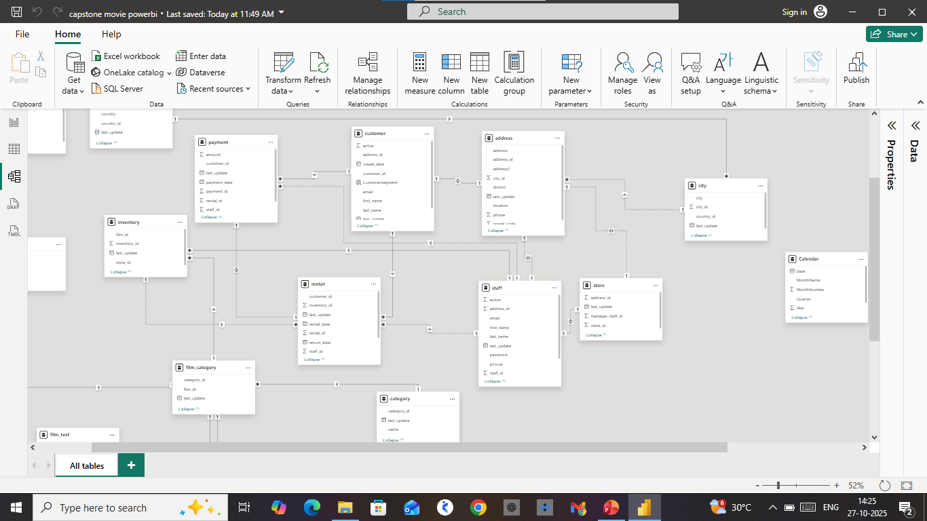
Data Preparation & Modeling
• Cleaned and validated data using Power Query
• Removed duplicates and missing values
• Established relationships between key tables
• Data model connected via keys: film_id, customer_id, rental_id, store_id

Slide 6
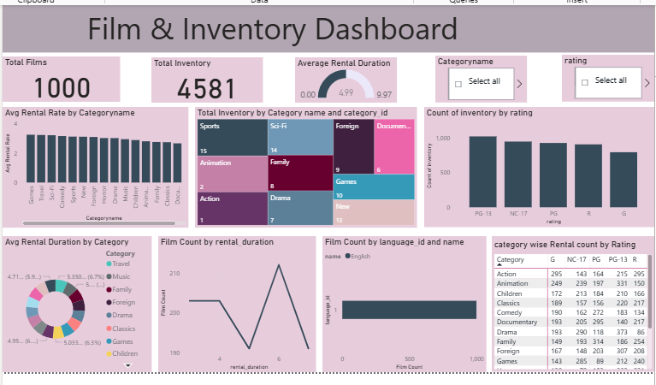
Dashboard Overview
• Built an interactive Power BI Dashboard
• KPIs: Total Sales, Rentals, Active Customers, Avg Rental Duration
• Visuals used: Bar, Line, Map, Pie, Donut charts

Slide 7
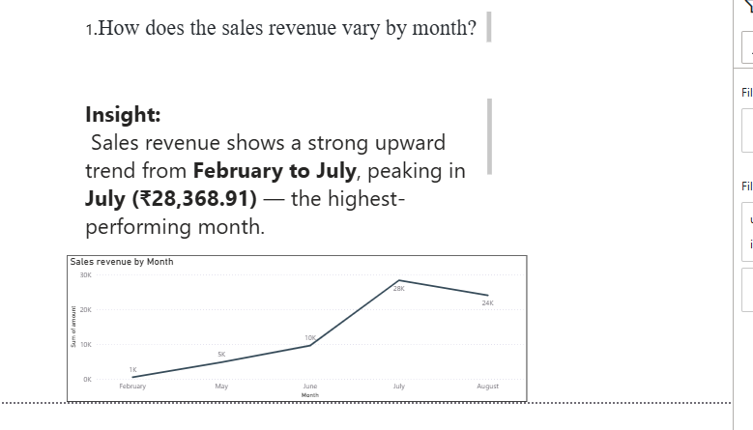
Sales Revenue by Month
Insight: Monthly sales show clear seasonality.
Highlight: July recorded the highest revenue.
Action: Plan marketing and promotions in high-demand months.

Slide 8
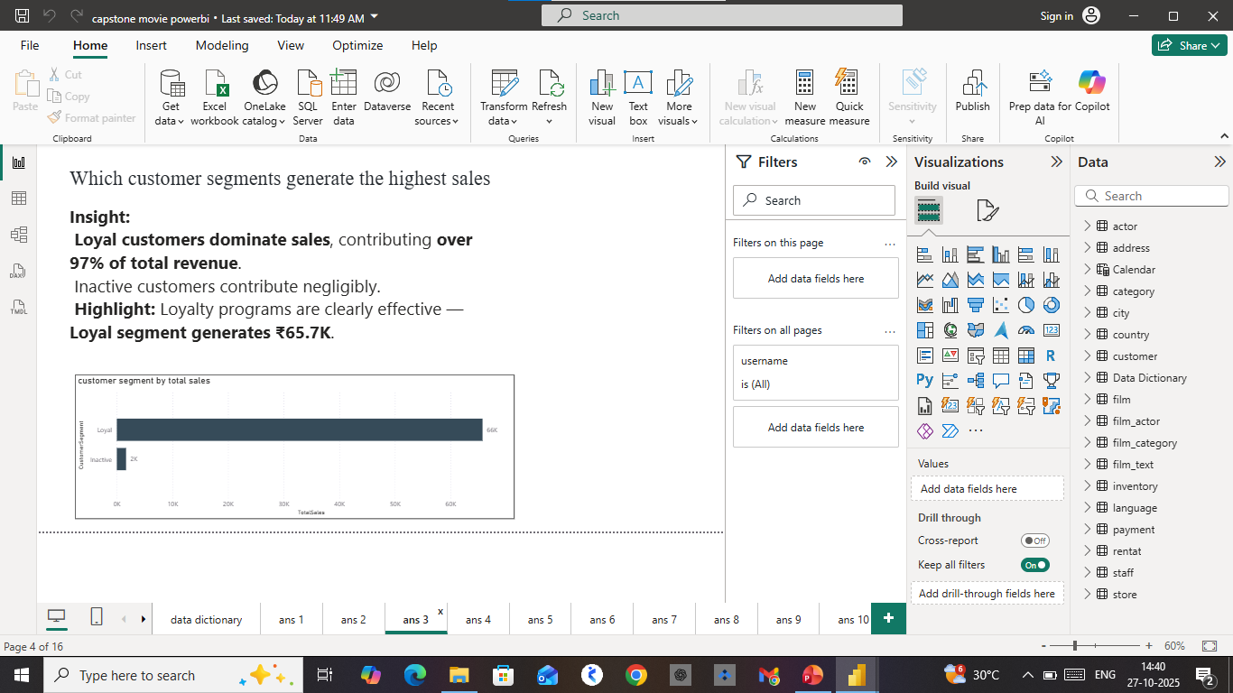
Sales by Customer Segment & Payment
Insight: VIP and Regular customers contribute majority sales.
Action: Offer targeted loyalty benefits for top segments.

Slide 9
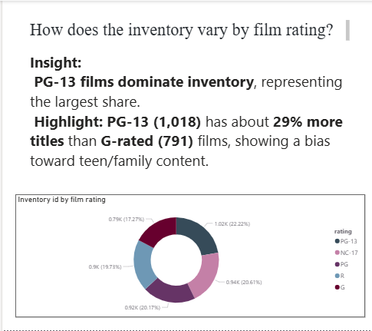
Inventory & Film Insights
Insight: Most inventory consists of PG and PG-13 rated films.
Action and Drama are most stocked genres.
Action: Balance inventory with higher demand categories.

Slide 10
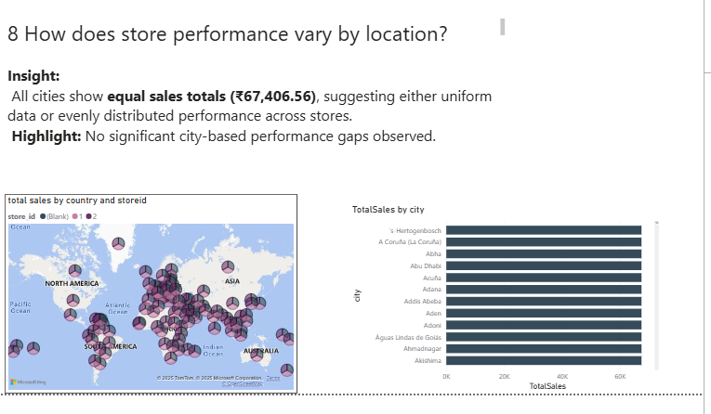
Store & Location Performance

Slide 11
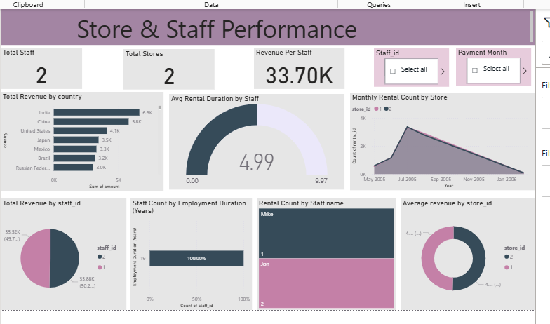
Staff Performance
Insight: Staff 1 has highest rental handling rate and efficiency.
Action: Recognize top performers and train underperforming staff.

Slide 12
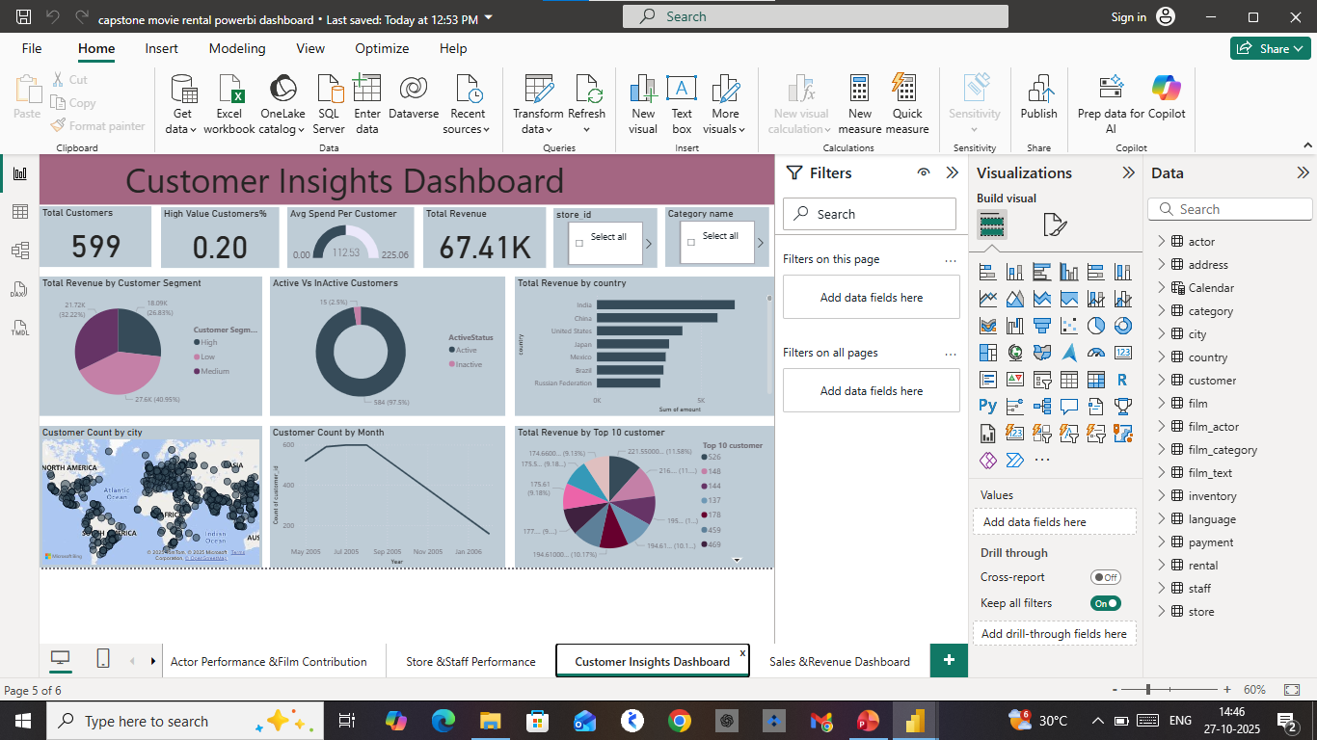
Customer Analysis
Insight: Most customers are concentrated in major urban cities.
Top cities show higher repeat rentals.
Action: Run regional promotions and reward programs

Slide 13
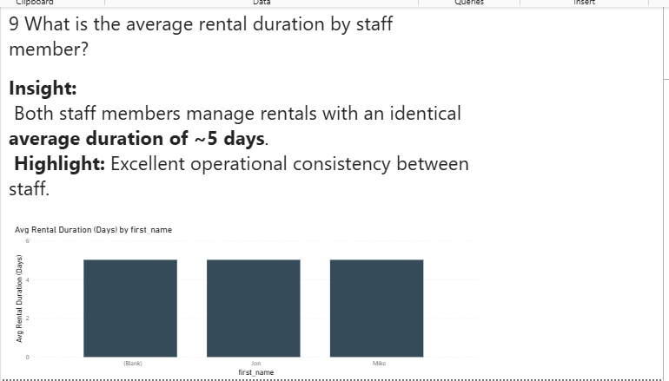
Rental Duration Insights
Insight: Average rental duration is 5 days; varies by staff and film category.
Action: Introduce flexible rental durations for premium customers.

Slide 14
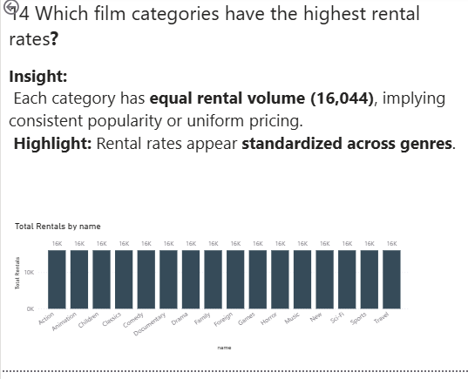
Top Performing Categories
Insight: Sports, Action, and Drama categories have highest rental rates.
Action: Focus marketing on top categories.

Slide 15
Key Insights Summary
• Highest Revenue Month: July
• Top Genre: Action & Drama
• Top City: Aurora
• Most Common Rating: PG-13
• Avg Rental Duration: 5 days

Slide 16
Recommendations & Conclusion
Recommendations:
1. Focus marketing during high-revenue months.
2. Expand top-performing categories and cities.
3. Reward loyal customers.
4. Monitor staff productivity.
Conclusion:
The Power BI dashboard enables data-driven decisions to enhance revenue and customer satisfaction.

